Slide 1
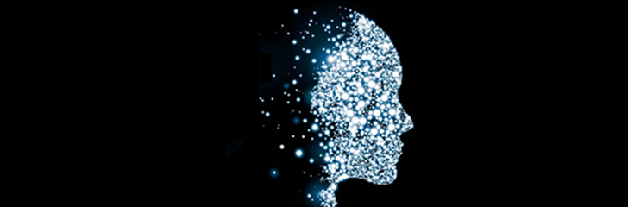
S/4HANA Machine Learning Workshop Bangalore, Shanghai, Walldorf Q3/2018
S/4HANA Architecture and Enablement, Palo Alto

Slide 2
Introduction to Machine Learning (3-Day Training)
This 3-day training is for everyone interested in acquiring a good understanding of machine learning principles. We will cover the most important machine learning algorithms for supervised and unsupervised learning (including linear regression and multinomial logistic regression, decision trees and random forest (for both classification and prediction), support vector machines, k-means and hierarchical clustering as well as principle component analysis. (Additional algorithms may be covered if time permits.) Every algorithm will be explained in detail and participants should be able (at least in principle) to implement some of the algorithms on their own.
We will utilize Jupyter notebooks and the very popular Python-based Scikit-Learn for exercises and data visualization. Scikit-Learn provides a consistent framework for building end-to-end machine learning pipelines including various tools to evaluate the trained models. It is also supported by Leonardo ML.
After having gained a solid background in machine learning, we will contrast Scikit-Learn with HANA’s Predictive Analysis Library (PAL) and SAP Predictive Analysis.

Slide 3
Scalable Machine Learning (1-Day Training) Introduction to TensorFlow (1-Day Training)
Scalable Machine Learning and Introduction to Neural Networks
Many recent improvements in ML are attributed to the availability of large datasets and powerful distributed compute environments. Course participants will learn how to combine corporate data (stored in HANA) with large, public datasets (stored in Hadoop), and how to utilize the parallel machine learning algorithms that are available in Apache Spark ML and TensorFlow to train machine learning models in a Kubernetes-based compute cluster. The trained models can be applied from virtually any application either by submitting a job to a Spark cluster or via TensorFlow’s high-performance serving system.
Introduction to TensorFlow
Learn how to use TensorFlow to build simple classifiers (hands-on exercises). We will also cover (without exercises) how to use convolutional and recurrent neural networks to solve problems such as image recognition, text understanding, and time series forecasting. In addition to training machine learning models from scratch, we will describe so-called transfer learning which allows us to utilize complex pre-trained models as a starting point for training models in a much shorter period of time.

Slide 4
Agenda: Day 4
Scalable Machine Learning
Introduction to PySpark and Spark ML
Data Preparation
Data Pipelines in Spark
TensorFlow
Introduction to Neural Networks and Deep Learning
Introduction to Deep Learning
Logistic Regression as a Neural Network
Shallow Neural Network
Deep Neural Networks
Backpropagation
Hands-on: Implement a neural network from scratch

Slide 5
Agenda
Neural Networks
Regularization
Optimizers
Introduction to TensorFlow and Keras, and PyTorch
Basic TF Concepts: Graphs, Sessions
TensorBoard
TensorFlow Serving
HANA EML
Keras
PyTorch
Convolutional Neural Networks
Transfer Learning
Autoencoders
Denoising Autoencoders
Recurrent Neural Networks
LSTMs
Generative Neural Networks
AR Models
Variational Autoencoders
Generative Adversarial Networks (GANs)
Training Best Practices
Model Serving
Leonardo ML
HANA EML
OpenSource
TensorFlow Serving
RISELab Clipper
Seldon-Core
Advanced Features
SLAs, Caching, Batching, A/B Testing, …

Slide 6
What is Machine Learning?

Slide 7
Introduction to TensorFlow

Slide 8
What isTensorFlow?
Open Source library developed by Google Brain Team
Created for tasks requiring heavy numerical computations
Machine Learning & Deep Learning are main applications
Similar frameworks are Caffe, Theano, Torch, among others
TensorFlow™ is an open source software library for numerical computation using data flow graphs. Nodes in the graph represent mathematical operations, while the graph edges represent the multidimensional data arrays (tensors) communicated between them.
Source: Google

Slide 9
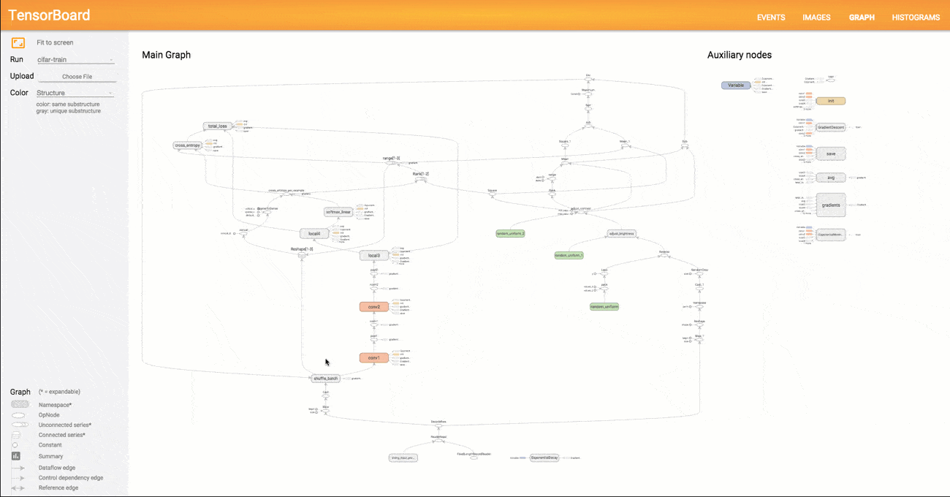
What isTensorFlow?
Conceptually based on Data Flow Graphs containing the following computation units:
Nodes = Mathematical Operations
Edges = n-dim Arrays (Tensors)
Some higher-level APIs (i.e. abstraction layers) are avaliable further simplifying the use of TF Examples: Tflearn, Keras, TF-Slim, among others
Notes:
Trainer Notes
Further details on TensorBoard can be found here: https://www.tensorflow.org/get_started/graph_viz
During research, the use of the above mentioned abstraction layers can be beneficial. Whereas, such tools typically come at the price of reduced functionality and require specific licensing. Therefore, they are generally not recommended for product development-related use

Slide 10
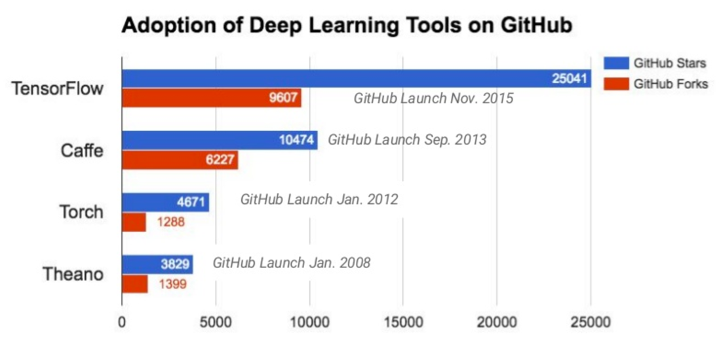
TensorFlow
Source: http://donnemartin.com/viz/pages/2015 // Jeff Dean, Large Scale Deep Learning with TensorFlow, Spark Summit 2016

Slide 11
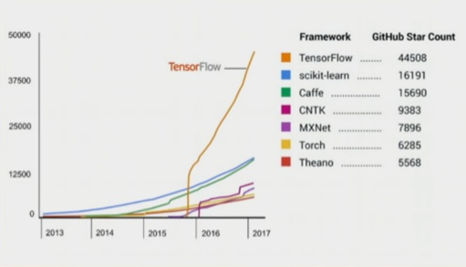
Growth rates based on GitHub star count

Slide 12
Why use TensorFlow?
Wide adoption
Extremely versatile library
Covers both ML research and productive use of ML
Provides Python, Java, C++, and Go APIs Python API is the most complete and easiest to use
Good performance due to C/C++ backend (soon: XLA – Accelerated Linear Algebra)
Supports CPUs, GPUs and distributed (cluster-based) processing
Integration with SAP Leonardo ML is planned
TensorFlow Serving (TF‘s model server) can be accessed from within HANA 2.0
Notes:
Trainer Notes
As with SAP Leonardo we embrace open standards, data scientists will be able to apply frameworks such as TensorFlow to develop their models
Please outline the integration of TensorFlow with SAP Leonardo once relevant information has become available
You may want to share the following video provided by Google introducing Tensorflow: https://youtu.be/mWl45NkFBOc

Slide 13
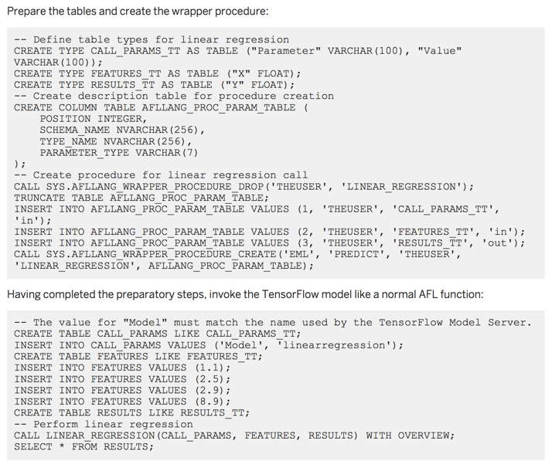
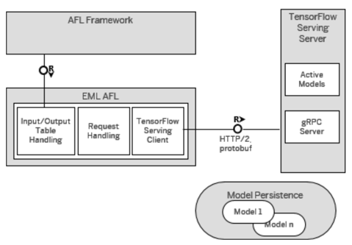
SAP HANA 2.0 – TensorFlow Serving Integration

Slide 14
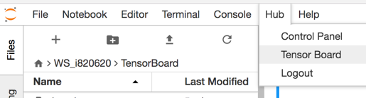
Nice Features
Automatic calculation of gradients (autodiff / GradientDescentOptimizer)
Parallel Processing
TensorFlow Serving
Both low-level and high-level functionality
TensorBoard

Slide 15
Spark Integration
Spark-Tensorflow-Connector
SparkDF.write.format("tfrecords").option("recordType", "Example").save("youtube-8m-video.tfrecord")
val newSparkDF: DataFrame =
spark.read.format("tfrecords").option("recordType", "Example").schema(videoSchema).load("youtube-8m-video.tfrecord")
(https://github.com/tensorflow/ecosystem/tree/master/spark/spark-tensorflow-connector)
Databricks: TensorFrames https://github.com/databricks/tensorframes
https://databricks.com/blog/2016/01/25/deep-learning-with-apache-spark-and-tensorflow.html
Yahoo: TensorFlowOnSpark https://github.com/yahoo/TensorFlowOnSpark

Slide 16
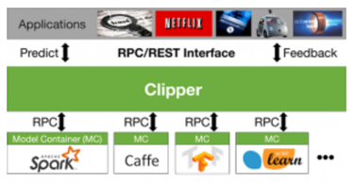
Outlook
Most Important topics within SAP should include:
State-of-the-art model server for Hana, ABAP and SCP
(Similar to Clipper?)
Transfer Learning (w/ customer scenarios)
Recurrent Neural Networks / (Long Short-Term Memory (LSTM)
Time series analysis with variable periodicity

Slide 17
FCN

Slide 18
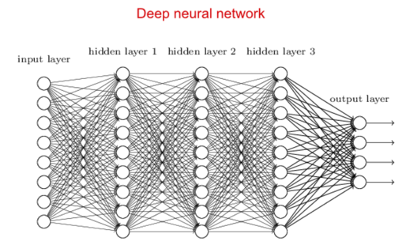

Slide 19
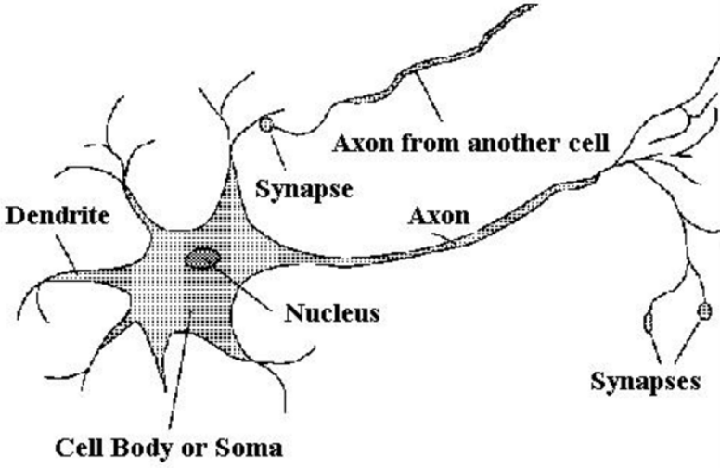
Biological Neuron
A neuron is composed of a cell body containing the nucleus and many extensions called dendrites, as well as one long extension, the so-called axon.
The end of the axon splits into many branches (telodendria) whose tips contain synaptic terminals (or synapses) which are connected to the dendrites of other neurons.
Neurons receive incoming electrical impulses (“signals”) from other neurons via synapses.
When a sufficient number of signals from other neurons are received, the neuron fires its own signals.

Slide 20
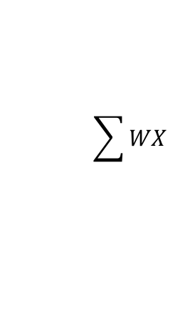
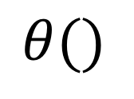
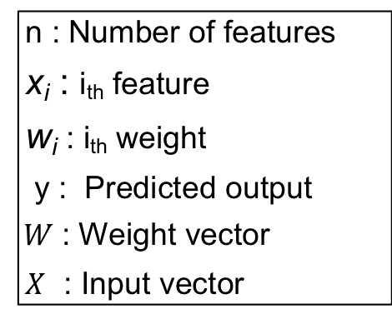
Multi-Layer Perceptron
Bias
b
x₁
w₁
Activation
Function
Output
y
x₂
w₂
$$\sum{WX}$$
$$θ()$$
Inputs
T
n : Number of features
x_{i} : i_{th} feature
w_{i} : i_{th} weight
y : Predicted output
$W$: Weight vector
$X$ : Input vector
Weighted Sum
of its Inputs
x_{n}
w_{n}
Weights

Slide 21
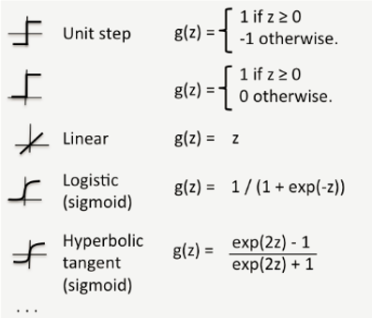
Multi-Layer Perceptron
Bias
b
x₁
w₁
Activation
Function
Output
y
x₂
w₂
$$\sum{WX}$$
$$θ()$$
Inputs
T
Weighted Sum
of its Inputs
x_{n}
w_{n}
Weights

Slide 22
Linear Separability
OR
AND
XOR
1
X
X
1
X
1
X
X
X
0
1
0
1
0
1
x₁ | x₂ | y
0 | 0 | 0
0 | 1 | 1
1 | 0 | 1
1 | 1 | 1
x₁ | x₂ | y
0 | 0 | 0
0 | 1 | 0
1 | 0 | 0
1 | 1 | 1
x₁ | x₂ | y
0 | 0 | 0
0 | 1 | 1
1 | 0 | 1
1 | 1 | 0

Slide 23
Linear Separability
OR
AND
XOR
1
X
1
X
1
X
X
X
X
0
1
0
1
0
1
Linearly separable
Linearly separable
Not linearly separable

Slide 24
Neural Network - Architecture
Hidden layer
Input layer
Output layer
X₁
A
y
X₂
B
Two hidden units (The input layer is not counted.)

Slide 25
Feed Forward Neural Network
Two hidden units
x₁
x₂
Input layer
Output layer
Hours of Sleep | Hours of Study
8 | 5
6 | 7
10 | 3
x₁
A
Exam Score
75
67
70
Y
x₂
B
Features
Labels

Slide 26
Feed Forward Neural Network - Mechanism
x₁
x₂
WA1
Hours of Sleep | Hours of Study
8 | 5
6 | 7
10 | 3
x₁
A
WYa
Exam Score
75
67
70
WA2
Y
x₂
B
WYb

Slide 27
Feed Forward Neural Network - Mechanism
x₁
x₂
Hours of Sleep | Hours of Study
8 | 5
6 | 7
10 | 3
x₁
A
WYa
Exam Score
75
67
70
WB1
Y
x₂
B
WYb
WB2

Slide 28
Feed Forward Neural Network - Mechanism
x₁
x₂
8
Hours of Sleep | Hours of Study
8 | 5
6 | 7
10 | 3
x₁
A
Exam Score
75
67
70
Y
5
x₂
B

Slide 29
Feed Forward Neural Network - Mechanism
x₁
x₂
8
x₁
8*WA1
A
Hours of Sleep | Hours of Study
8 | 5
6 | 7
10 | 3
Exam Score
75
67
70
5*WA2
Y
5
x₂
B

Slide 30
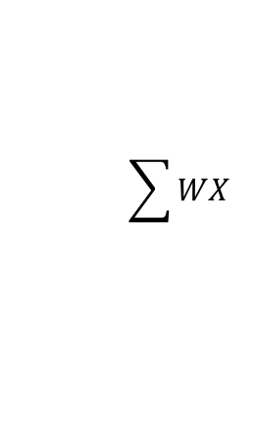
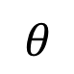
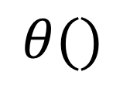
Feed Forward Neural Network - Mechanism
$$\sum{WX}$$
$$θ()$$
T
8*WA1 + 5*WA2
$$θ$$
(8*WA1 + 5*WA2)
x₁
x₂
8
x₁
8*WA1
A
Hours of Sleep | Hours of Study
8 | 5
6 | 7
10 | 3
Exam Score
75
67
70
5*WA2
Y
5
x₂
B

Slide 31
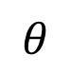
Feed Forward Neural Network - Mechanism
x₁
x₂
8
$$θ$$
(8*WA1 + 5*WA2)
Hours of Sleep | Hours of Study
8 | 5
6 | 7
10 | 3
x₁
A
Exam Score
75
67
70
WB1
WYa
Y
5
WYb
x₂
B
WB2
?

Slide 32
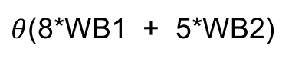
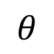
Feed Forward Neural Network - Mechanism
x₁
x₂
8
$$θ$$
(8*WA1 + 5*WA2)
Hours of Sleep | Hours of Study
8 | 5
6 | 7
10 | 3
x₁
A
Exam Score
75
67
70
WYa
Y
5
WYb
x₂
B
$θ$(8*WB1 + 5*WB2)

Slide 33
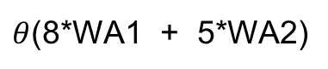
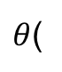
Feed Forward Neural Network - Mechanism
$$\sum{WX}$$
$$θ()$$
T
A
B
A
WYa *
+
WYb *
$θ$(
WYa *
B
)
+
WYb *
x₁
x₂
8
$θ$(8*WA1 + 5*WA2)
Hours of Sleep | Hours of Study
8 | 5
6 | 7
10 | 3
x₁
A
Exam Score
75
67
70
WYa
Y
5
WYb
x₂
B
$θ$(8*WB1 + 5*WB2)

Slide 34
Feed Forward Neural Network - Mechanism
$$\sum{WX}$$
$$θ()$$
T
A
B
A
WYa *
+
WYb *
$θ$(
WYa *
B
)
+
WYb *
x₁
x₂
8
$θ$(8*WA1 + 5*WA2)
Hours of Sleep | Hours of Study
8 | 5
6 | 7
10 | 3
x₁
A
Exam Score
75
67
70
WYa
2
Y
-
)
(
5
WYb
x₂
B
$θ$(8*WB1 + 5*WB2)
Error function E()

Slide 35
Feed Forward Neural Network – How to Learn Pattern?
x₁
x₂
8
Goal: Minimize the Mean Sqare Error
Hours of Sleep | Hours of Study
8 | 5
6 | 7
10 | 3
x₁
A
Exam Score
75
67
70
Y
-
2
(
)
5
x₂
B

Slide 36
Feed Forward Neural Network – How to Learn Pattern?
x₁
x₂
8
Goal: Minimize the Mean Square Error
Hours of Sleep | Hours of Study
8 | 5
6 | 7
10 | 3
x₁
A
Exam Score
75
67
70
Y
-
2
(
)
5
x₂
B
WA1 | WB1 | WYa
WA2 | WB2 | WYb
Adjust
Least erf()

Slide 37
Feed Forward Neural Network – How to Learn Pattern?
x₁
x₂
8
Goal: Minimize MSE
Hours of Sleep | Hours of Study
8 | 5
6 | 7
10 | 3
x₁
A
Exam Score
75
67
70
Y
-
2
(
)
5
x₂
B
WA1 | WB1 | WYa
WA2 | WB2 | WYb
Adjust
Least erf()
?

Slide 38
Feed Forward Neural Network – How to Learn Pattern?
x₁
x₂
8
Goal: Minimize MSE
Hours of Sleep | Hours of Study
8 | 5
6 | 7
10 | 3
x₁
A
Exam Score
75
67
70
Y
-
2
(
)
5
x₂
B
WA1 | WB1 | WYa
WA2 | WB2 | WYb
Adjust
Least erf()
Gradient descent

Slide 39
Apply Weights to Input Data
8*WA1 + 5*WA2
?
T
8
5
WA1
WA2
WA1
WA2
8
5
*
*
T
8
5
WA1
WA2
*

Slide 40
Apply Weights to Input Data
8*WA1 + 5*WA2
?
T
8
5
WA1
WA2
WA1
WA2
8
5
*
*
T
8
5
WA1
WA2
*

Slide 41
Simplify Calculation – How?
x₁
x₂
8
Hours of Sleep | Hours of Study
8 | 5
6 | 7
10 | 3
x₁
A
?
5
x₂
B
?
?
8
5
WA1 | WB1
WA2 | WB2
*

Slide 42
Simplify Calculation – How?
x₁
x₂
8
Hours of Sleep | Hours of Study
8 | 5
6 | 7
10 | 3
x₁
A
8*WA1 + 5*WA2
8*WB1 + 5*WB2
5
x₂
B
Don’t forget to apply the activation function
T
8
5
WA1 | WB1
WA2 | WB2
*

Slide 43
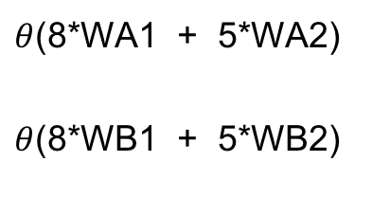
Simplify Calculation – How?
x₁
x₂
8
Hours of Sleep | Hours of Study
8 | 5
6 | 7
10 | 3
x₁
A
$θ$(8*WA1 + 5*WA2)
$θ$(8*WB1 + 5*WB2)
5
x₂
B
T
8
5
WA1 | WB1
WA2 | WB2
*

Slide 44
Simplify Calculation – How?
x₁
x₂
8
Hours of Sleep | Hours of Study
8 | 5
6 | 7
10 | 3
x₁
A
Y
?
5
x₂
B

Slide 45
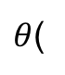
Simplify Calculation – How?
x₁
x₂
8
Hours of Sleep | Hours of Study
8 | 5
6 | 7
10 | 3
x₁
A
Y
A
B
$θ$(
WYa *
+
WYb *
)
5
x₂
B

Slide 46
Gradient Descent - How?
x₁
x₂
8
Goal: Minimize MSE
Hours of Sleep | Hours of Study
8 | 5
6 | 7
10 | 3
x₁
A
Exam Score
75
67
70
Y
-
2
(
)
5
x₂
B
Why ?

Slide 47
Gradient Descent - How?
x₁
x₂
8
Goal: Minimize MSE
Hours of Sleep | Hours of Study
8 | 5
6 | 7
10 | 3
x₁
A
Exam Score
75
67
70
Y
-
2
(
)
5
x₂
B
What influences the change in error function erf() ?

Slide 48
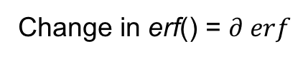
Gradient Descent - How?
x₁
x₂
8
Goal: Minimize MSE
Hours of Sleep | Hours of Study
8 | 5
6 | 7
10 | 3
x₁
A
Exam Score
75
67
70
Y
-
2
(
)
5
x₂
B
What influences the change in error function E() ?
/
WA1 | WB1 | WYa
WA2 | WB2 | WYb
How to calculate?
Change in erf() = $∂ erf$
Change in eeights

Slide 49
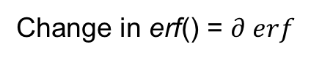
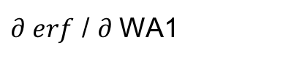
Gradient Descent - How?
x₁
x₂
8
Goal: Minimize MSE
Hours of Sleep | Hours of Study
8 | 5
6 | 7
10 | 3
x₁
A
Exam Score
75
67
70
Y
-
2
(
)
5
x₂
B
What influences the change in error function E() ?
/
WA1 | WB1 | WYa
WA2 | WB2 | WYb
$∂ erf$ / $∂$WA1
Change in erf() = $∂ erf$
Change in weights
=

Slide 50
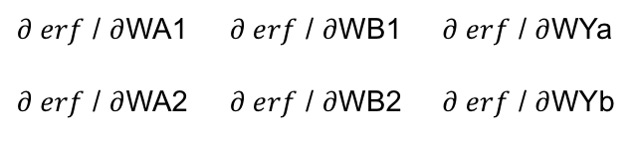
Gradient Descent - How?
x₁
x₂
8
Goal: Minimize MSE
Hours of Sleep | Hours of Study
8 | 5
6 | 7
10 | 3
x₁
A
Exam Score
75
67
70
Y
-
2
(
)
5
x₂
B
$∂ erf$ / $∂$WA1 | $∂ erf$ / $∂$WB1 | $∂ erf$ / $∂$WYa
$∂ erf$ / $∂$WA2 | $∂ erf$ / $∂$WB2 | $∂ erf$ / $∂$WYb
/
Change in erf()
Change in weights
=

Slide 51
Gradient Descent - How?
x₁
x₂
8
Goal: Minimize MSE
Hours of Sleep | Hours of Study
8 | 5
6 | 7
10 | 3
x₁
A
Exam Score
75
67
70
Y
-
2
(
)
5
x₂
B
-
WA1
Learning rate * (
$∂ erf$ / $∂$WA1 | $∂ erf$ / $∂$WB1 | $∂ erf$ / $∂$WYa
$∂ erf$ / $∂$WA2 | $∂ erf$ / $∂$WB2 | $∂ erf$ / $∂$WYb
Now comes the learning.
Why?

Slide 52
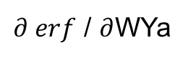
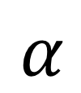
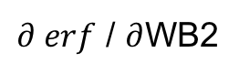
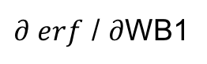
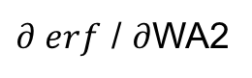
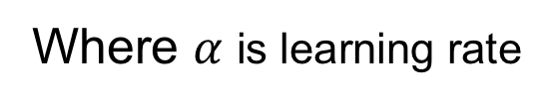
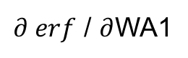
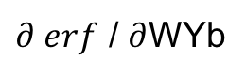
Gradient Descent - How?
Old weights
Partial derivative of error function with respect to weights
New updated weights
‘
WA1
$∂ erf$ / $∂$WA1
WA1
‘
WA2
$∂ erf$ / $∂$WA2
WA2
‘
WB1
-
$$α$$
$∂ erf$ / $∂$WB1
WB1
=
*
‘
WB2
$∂ erf$ / $∂$WB2
WB2
WYa
WYa
$∂ erf$ / $∂$WYa
‘
‘
WYb
$∂ erf$ / $∂$WYb
WYb
Where $α$ is learning rate

Slide 53
How Neural Network Solve a Problem - Example of Non-Linearly Separable Data
c
a | b | c | y
0 | 0 | 0 | 0
0 | 0 | 1 | 1
0 | 1 | 0 | 1
0 | 1 | 1 | 0
1 | 0 | 0 | 1
1 | 0 | 1 | 0
1 | 1 | 0 | 0
1 | 1 | 1 | 1
b
a

Slide 54
Multilayer Perceptron
c
P₁
y₁
y₂
y₃
111
P₁
P₂
P₃
P₂
P₃
_{b}
011
a
b
c
a
000
001

Slide 55
Convolutional Neural Networks

Slide 56
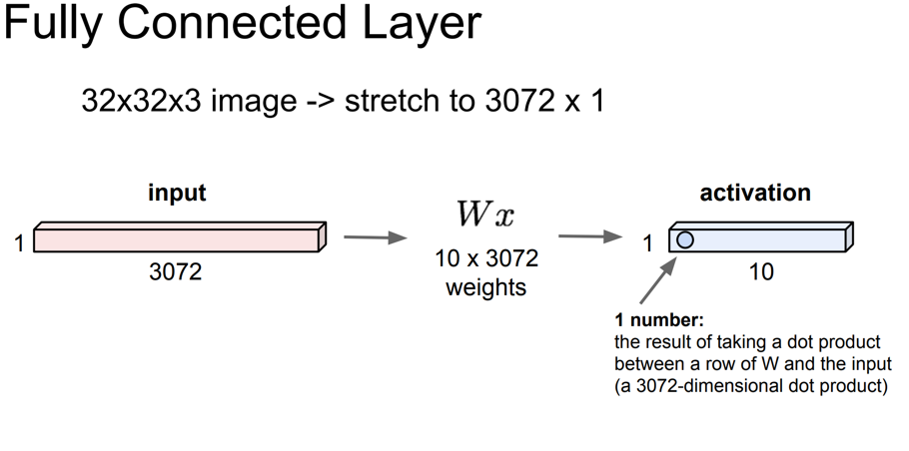
Convolutional Neural Networks (Contents: CS231n)

Slide 57
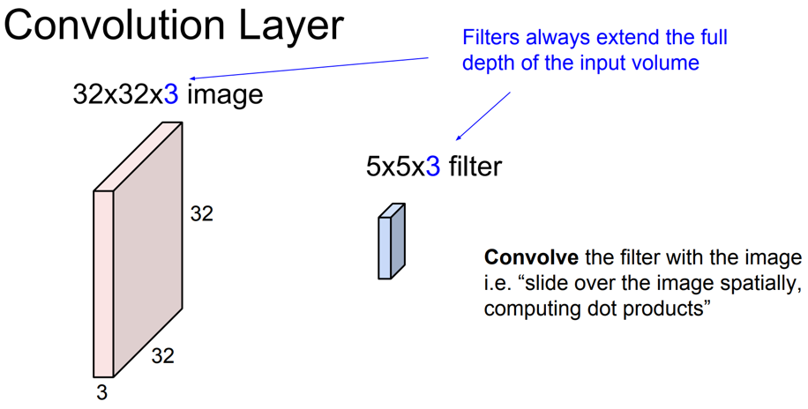
Convolutional Neural Networks

Slide 58
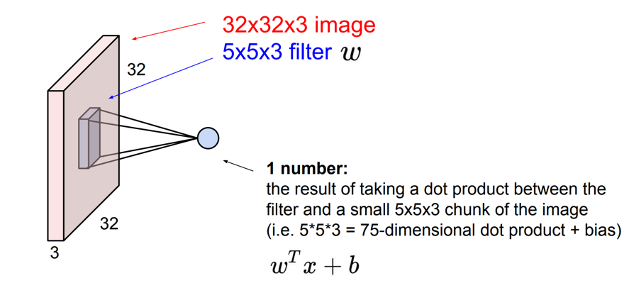
Convolutional Neural Networks

Slide 59
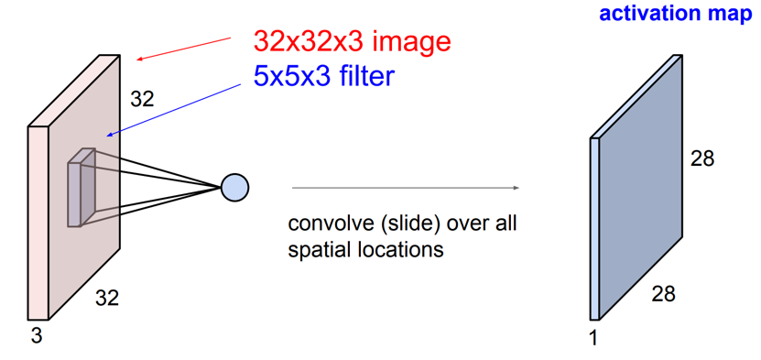
Convolutional Neural Networks

Slide 60
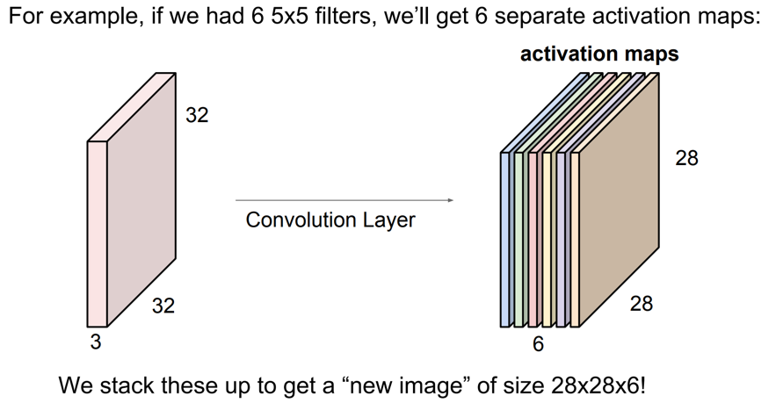
Convolutional Neural Networks

Slide 61
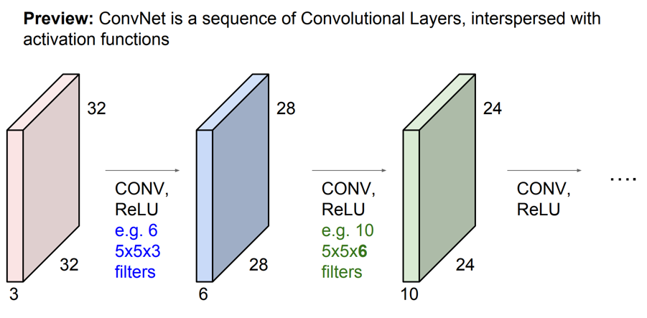
Convolutional Neural Networks

Slide 62
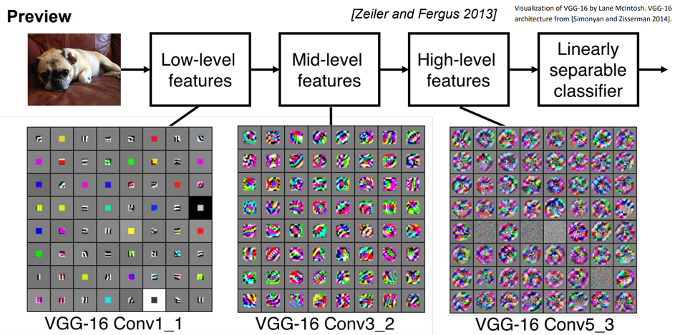
Convolutional Neural Networks

Slide 63
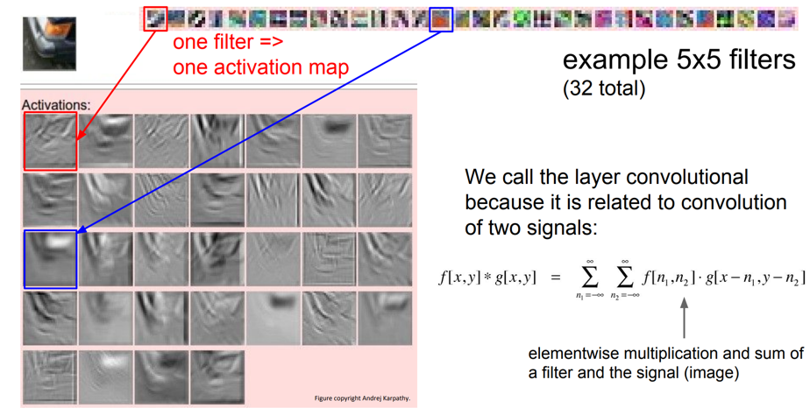
Convolutional Neural Networks

Slide 64
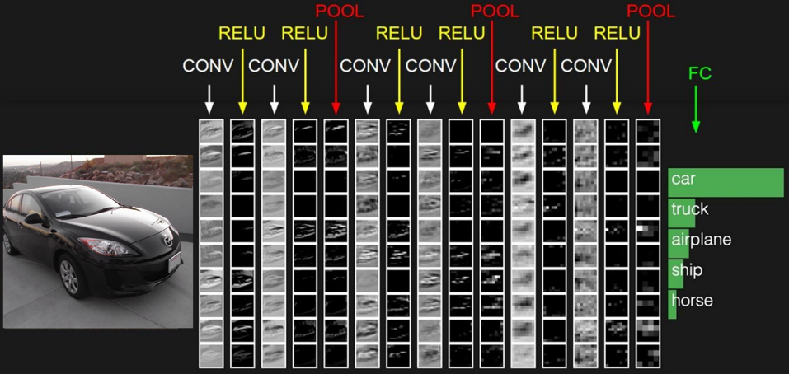
Convolutional Neural Networks

Slide 65
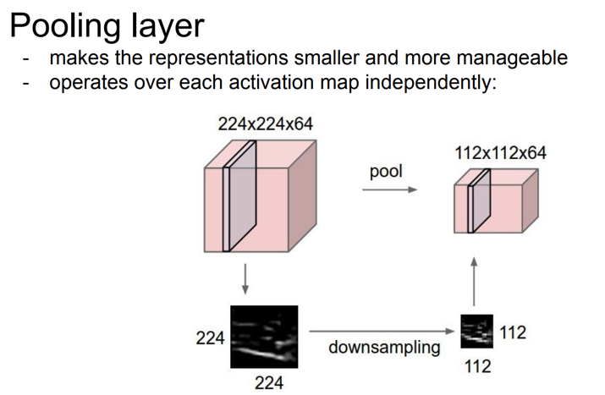
Convolutional Neural Networks

Slide 66
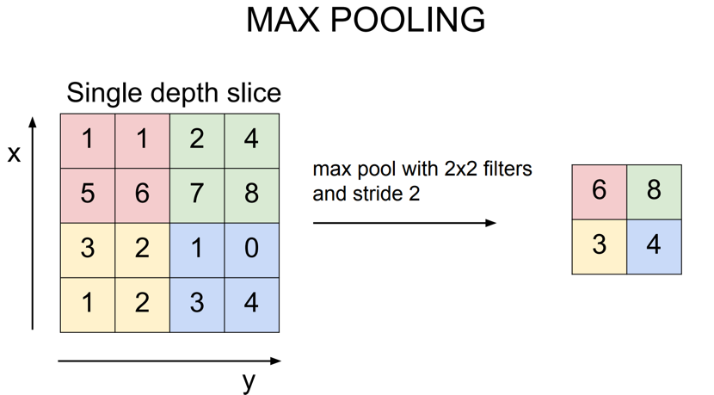
Convolutional Neural Networks

Slide 67
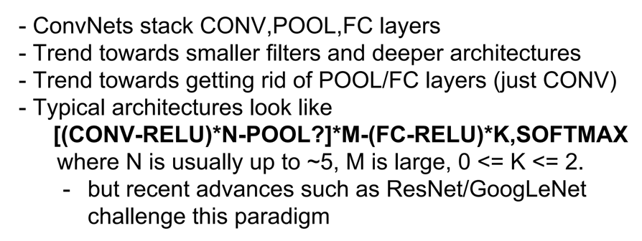
Convolutional Neural Networks

Slide 68
Transfer Learning

Slide 70
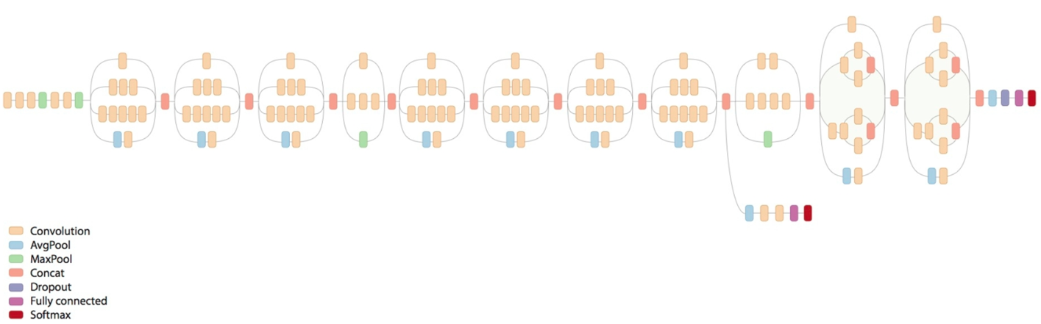
Inception V3

Slide 71
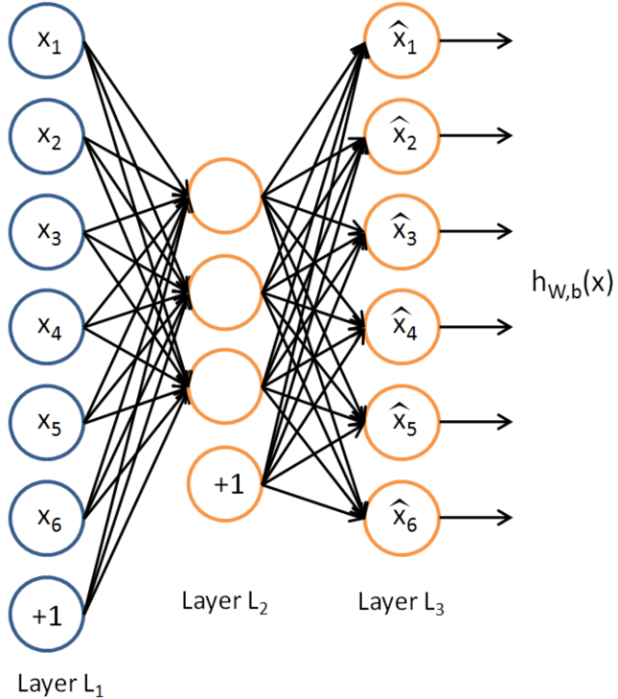

Autoencoders

Slide 72
Recurrent Neural Networks

Slide 73

Recurrent Neural Networks
“Unrolling” a recurrent neuron through time.

Slide 74

Recurrent Neural Networks

Slide 75

Recurrent Neural Networks - LSTMs

Slide 76
Recurrent Neural Networks / LSTMs
http://colah.github.io/posts/2015-08-Understanding-LSTMs/

Slide 77
Generative Models
Variational Autoencoders (VAs)
Probabilistic (Outputs are partly determined by chance)
VAs are used for generating new instances that are similar to the instances from the training set
Generative Adversarial Networks (GANs)
https://medium.com/@jonathan_hui/gan-some-cool-applications-of-gans-4c9ecca35900

Slide 78

Standard autoencoders cannot be used as a generative model.
If we add a constraint to the encoding network to create latent vectors that follow a Gaussian distribution, the decoding part of the network can be used to generate new output. The creation on the latent vectors is achieved by modifying the loss function to be the sum of the mean squared error + latent loss.
Source: https://www.doc.ic.ac.uk/~js4416/163/website/autoencoders/variational.html

Slide 79

Deep Dream
http://www.datascienceassn.org/content/tensorflow-tutorial-deepdream-algorithm

Slide 80

Generative Adversarial Networks (GANs)

